Slide 2
Other Procedures - Section 8

Slide 3
Objectives
Understanding Section 8- Other Procedures
Clinical examples for better understanding
Knowledge Check
Exercises

Slide 4

Other Procedures
The Other Procedures section contains codes for procedures not included in the other medical and surgical-related sections. A single root operation, Other Procedures.
Other Procedures is defined as Methodologies which attempt to remediate or cure a disorder or disease.
There are relatively few procedure codes in this section, for nontraditional, whole body therapies including acupuncture, meditation and yoga therapy. There is also a code for the fertilization portion of an in-vitro fertilization procedure.

Slide 5
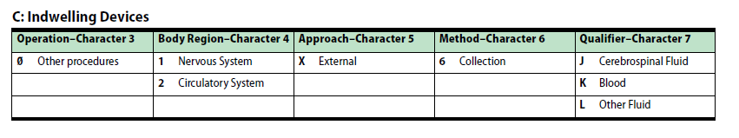
Other Procedures 8C0-8E0
Character Meanings

Slide 6
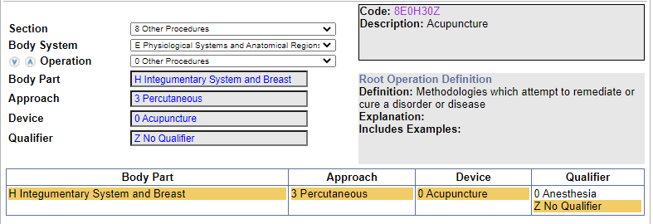
Clinical Example 1
Acupuncture
Coding Navigation:

Slide 7
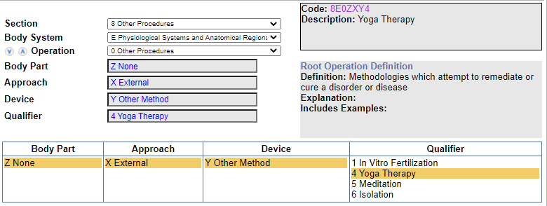
Clinical Example 2
Yoga
Coding Navigation:

Slide 8
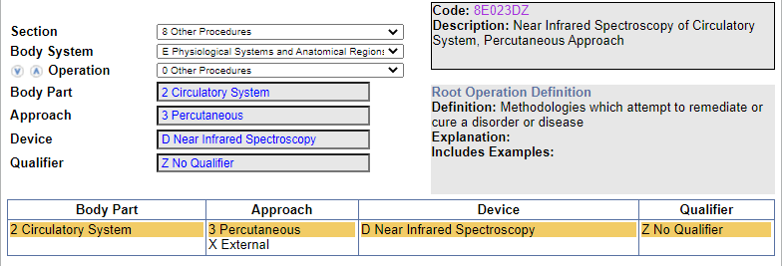
Knowledge Check 1
What is the code assignment for Near infrared spectroscopy of leg vessels?
Codes: 8E023DZ (Near Infrared Spectroscopy of Circulatory System, Percutaneous Approach)
Code Navigation:

Slide 9
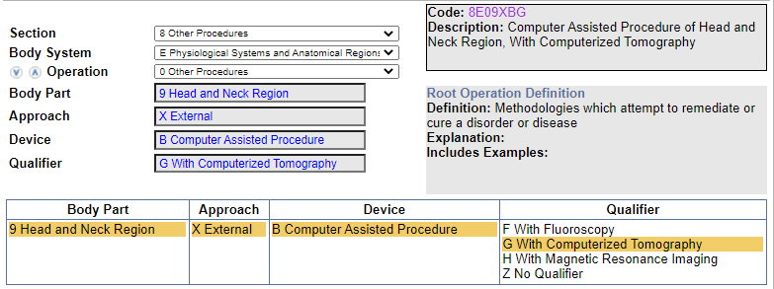
Knowledge Check 2
What is the code assignment for CT computer assisted sinus surgery?
Code: 8E09XBG (Computer Assisted Procedure of Head and Neck Region, With Computerized Tomography) Note: The primary procedure is coded separately
Code Navigation:

Slide 10
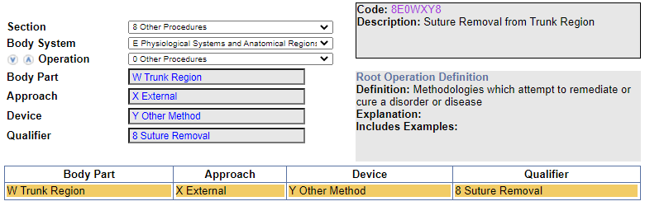
Exercise 1
What is the code assignment for Suture removal, abdominal wall?
Code: 8E0WXY8 (Suture Removal from Trunk Region)
Code Navigation:

Slide 11
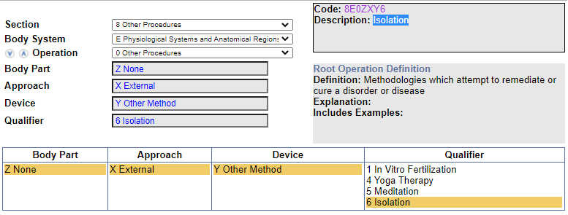
Exercise 2
What is the code assignment for Isolation after infectious disease exposure?
Code: 8E0ZXY6 (Isolation)
Code Navigation:

Slide 12
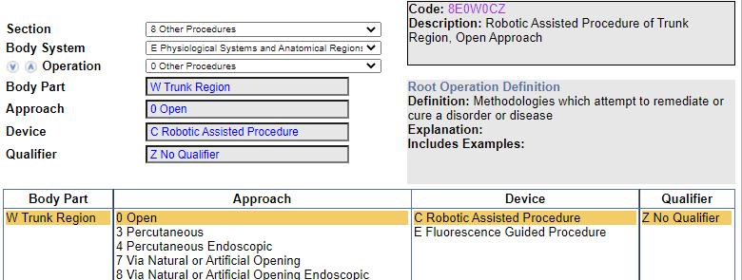
Exercise 3
What is the code assignment for Robotic assisted open prostatectomy?
Code: 8E0W0CZ (Robotic Assisted Procedure of Trunk Region, Open Approach)
Note: The primary procedure is coded separately.
Code Navigation:

Slide 13
Thank You

